Slide 1
Bus Arbitration

Slide 2
Bus Arbitration
Process by which the next device to become bus master is selected and bus master ship is transferred to it
Device allowed to initiate data transfers on the bus at any given time is called bus master.
Two Approaches for bus Arbitration
→Centralized-Single bus arbiter perform the required arbitration.
→Distributed- All devices participate in selecting next bus master.

Slide 3
Centralized Arbitration
Bus arbiter may be processor /separate unit connected to bus.
DMA controller indicated its request by BR(Bus Request)
Once BR is activated processor will activate BG(Bus Grant)
BG indicates to the DMA controller that they may use the when it is free.
Daisy chain arrangement
Current bus master activates BBSY(bus busy) signal.
Timing diagram

Slide 4
DMA Controller 2 requests and Acquire bus

Slide 5
Distributed Arbitration
All the devices waiting for a bus will involve in arbitration process.
No Central arbiter.
→Each device is assigned 4 bit ID
→When multiple device request for bus they assert Start Arbitration signal and place their ID on four lines, ARB0 through ARB3.
→Winner is selected based on the signal generated Code on four lines represents the code with highest ID
Example A→0101 and B→0110 A OR B =0111
A AND (0111)=0100 , B AND (0111)=0110.
→Offers higher reliability as not centralized

Slide 6
BUSES
Provides communication path for transfer of data, interrupts, arbitration
A bus protocol is the set of rules that govern the behavior of various devices connected to the bus, as to when to place information on the bus, when to assert control signals, etc.
Bus lines may be grouped into three types:
Data
Address
Control-R/W, timing info(time at which P/IO place or receive data to and from bus)
Schemes for timing of data transfers over a bus can be classified into:
Synchronous,
Asynchronous.
Master(initiators,Processor/DMA controller) → slave (Target, other devices) concept

Slide 7
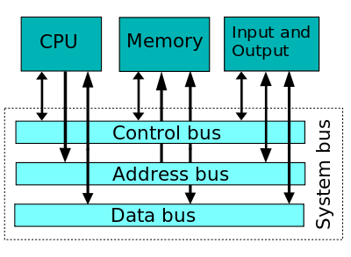
BUSES

Slide 8
Synchronous bus
All devices derive a timing info from same clock
Equally spaced pulse one data transfer can take place.
one bus clock cycle
Bus clock
Bus cycle

Slide 9
Synchronous bus
T
ime
Bus clock
Address and
command
Data
t
0
t
1
t
2
Master places the
device address and
command on the bus
with length of operand,
and indicates that
it is a Read operation.
Bus cycle
Addressed slave places
data on the data lines
Master “strobes” the data
on the data lines into its
input buffer, for a Read
operation.
In case of a Write operation, the master places the data on the bus along with the
address and commands at time t₀.
The slave strobes the data into its input buffer at time t₂.

Slide 10
Synchronous bus
Once the master places the device address and command on the bus, it takes time for this information to propagate to the devices:
This time depends on the physical and electrical characteristics of the bus.
Also, all the devices have to be given enough time to decode the address and control signals, so that the addressed slave can place data on the bus.
Width of the pulse t₁ - t₀ depends on:
Maximum propagation delay between two devices connected to the bus.
Time taken by all the devices to decode the address and control signals, so that the addressed slave can respond at time t₁.

Slide 11
Synchronous bus
At the end of the clock cycle, at time t₂, the master strobes the data on the data lines into its input buffer if it’s a Read operation.
“Strobe” means to capture the values of the data and store them into a buffer.
When data are to be loaded into a storage buffer register, the data should be available for a period longer than the setup time of the device.
Width of the pulse t₂ - t₁ should be longer than:
Maximum propagation time of the bus plus
Set up time of the input buffer register of the master.

Slide 12
Synchronous with Master and Slave
T
ime
Address &
command
appear on the
bus.
Bus clock
Data reaches
the master.
Seen by
master
t
AM
Address and
command
Address &
command reach
the slave.
Data
t
DM
Seen by slave
t
AS
Data appears
on the bus.
Address and
command
Data
t
DS
t
t
1
t
0
2
Signals do not appear on the bus as soon as they are placed on the bus, due to the
propagation delay in the interface circuits.
Signals reach the devices after a propagation delay which depends on the characteristics of the bus.
Data must remain on the bus for some time after t₂ equal to the hold time of the buffer.

Slide 13
Multiple cycle transfers
Drawback of single CC
Devices are very slow
All other devices should work at the speed of slowest device
So increase in timing of clock.
How to identify whether slave is working or not?
Use high frequency clock cycle
Clock of bus and processor(faster) is not common

Slide 14
Multiple cycle transfers
Address & command
requesting a Read
operation appear on
the bus.
T
ime
1
2
3
4
Clock
Address
Command
Master strobes data
into the input buffer.
Data
Sla
v
e-ready
Slave places the data on the bus,
and asserts Slave-ready signal.
Clock changes are seen by all the devices
at the same time.

Slide 15
Asynchronous Bus
Handshake between master and Slave
Master places the address and command information on the bus.
Asserts the Master-ready signal to indicate to the slaves that the address and command information has been placed on the bus.
All devices on the bus decode the address.
Addressed slave performs the required operation, and informs the processor it has done so by asserting the Slave-ready signal.
Master removes all the signals from the bus, once Slave-ready is asserted.
If the operation is a Read operation, Master also strobes the data into its input buffer.
Common clock is replace by Master ready and Slave ready
Skew (t1-t0) occurs when two signals are simultaneously transmitted from one source

Slide 16
Handshaking for READ operation
T
ime
Address
and command
Master-ready
Slave-ready
Data
t
0
t
1
t
2
t
3
t
4
t
5
Bus cycle

Slide 17
Handshaking for WRITE operation

Slide 18
Asynchronous vs. Synchronous bus
Advantages of asynchronous bus:
Eliminates the need for synchronization between the sender and the receiver.
Can accommodate varying delays automatically, using the Slave-ready signal.
Disadvantages of asynchronous bus:
Data transfer rate with full handshake is limited by two-round trip delays.
Data transfers using a synchronous bus involves only one round trip delay, and hence a synchronous bus can achieve faster rates.

Slide 19
PERIPHERAL COMPONENT INTERCONNECT(PCI)
Introduced in 1992
Low-cost bus
Processor independent system bus
Plug-and-play capability
Most memory transfers involve a burst of data rather than just one word.
The PCI is designed primarily to support this mode of operation.
The bus supports three independent address spaces: memory, I/O, and configuration.

Slide 20
Fig.4.38 is an example of computer connected directly to processor bus

Slide 21
Fig 4.39 PCI bridge provides a separate physical connection for Main Memory

Slide 22
we assumed that the master maintains the address information on the bus until data transfer is completed.
But, the address is needed only long enough for the slave to be selected.
The address is needed on the bus for one clock cycle only, freeing the address lines to be used for sending data in subsequent clock cycles. The result is a significant cost reduction.
A Complete operation on the bus involving an address and a burst of data is called transaction.
Individual word transfers within a transaction are called phases.

Slide 23
Data transfer signals on the PCI bus.
Name
F
unction
CLK
A
33-MHz
or
66-MHz
clock.
FRAME#
Sent
b
y
the
initiator
to
indicate
the
duration
of
a
transaction.
AD
32
address/data
lines,
which
may
b
e
optionally
increased
to
64.
C/BE#
4
command/byte-enable
lines
(8
for
a
64-bit
bus).
IRD
Y#,
TRD
Y#
Initiator-ready
and
Target-ready
signals.
DEVSEL#
A
response
from
the
device
indicating
that
it
has
recognized
its
address
and
is
ready
for
a
data
transfer
transaction.
IDSEL#
Initialization
Device
Select.

Slide 24
1
2
3
4
5
6
7
CLK
Frame#
AD
Adress
#1
#2
#3
#4
C/BE#
Cmnd
Byte Enable
IRD
Y#
TRD
Y#
DEVSEL#
A read operation on the PCI bus

Slide 25
Device Configuration
When an I/O device is connected to a computer, several actions are needed to configure both the device and the software that communicates with it.
PCI incorporates in each I/O device interface a small configuration ROM memory that stores information about that device.
The configuration ROMs of all devices are accessible in the configuration address space. The PCI initialization software reads these ROMs and determines whether the device is a printer, a keyboard, an Ethernet interface, or a disk controller. It can further learn bout various device options and characteristics.
Devices are assigned addresses during the initialization process.
This means that during the bus configuration operation, devices cannot be accessed based on their address, as they have not yet been assigned one.
Hence, the configuration address space uses a different mechanism. Each device has an input signal called Initialization Device Select, IDSEL#
Max 21 devices(AD11 to AD31).

Slide 26
Small Computer System Interface(SCSI)
The acronym SCSI stands for Small Computer System Interface.
It refers to a standard bus defined by the American National Standards Institute (ANSI) under the designation X3.131 .
In the original specifications of the standard, devices such as disks are connected to a computer via a 50-wire cable, which can be up to 25 meters in length and can transfer data at rates up to 5 megabytes/s.
The SCSI bus standard has undergone many revisions, and its data transfer capability has increased very rapidly, almost doubling every two years.
SCSI-2 and SCSI-3 have been defined, and each has several options.
Because of various options SCSI connector may have 50, 68 or 80 pins.

Slide 27
SCSI Bus
Devices connected to the SCSI bus are not part of the address space of the processor
The SCSI bus is connected to the processor bus through a SCSI controller. This controller uses DMA to transfer data packets from the main memory to the device, or vice versa.
A packet may contain a block of data, commands from the processor to the device, or status information about the device.
A controller connected to a SCSI bus is one of two types – an initiator or a target.
An initiator has the ability to select a particular target and to send commands specifying the operations to be performed. The disk controller operates as a target. It carries out the commands it receives from the initiator.
The initiator establishes a logical connection with the intended target.
Once this connection has been established, it can be suspended and restored as needed to transfer commands and bursts of data.
While a particular connection is suspended, other device can use the bus to transfer information.
This ability to overlap data transfer requests is one of the key features of the SCSI bus that leads to its high performance.

Slide 28
SCSI Bus (3)
Data transfers on the SCSI bus are always controlled by the target controller.
To send a command to a target, an initiator requests control of the bus and, after winning arbitration, selects the controller it wants to communicate with and hands control of the bus over to it.
Then the controller starts a data transfer operation to receive a command from the initiator.

Slide 29
SCSI Bus - Read Operation on Disk Drive(1)
Assume data are stored in disk sectors that are not contiguous.
The processor sends a command to the SCSI controller,
The SCSI controller, acting as an initiator, contends for control of the bus.
When the initiator wins the arbitration process, it selects the target controller and hands over control of the bus to it.
The target starts an output operation (from initiator to target); in response to this, the initiator sends a command specifying the required read operation.
The target, realizing that it first needs to perform a disk seek operation, sends a message to the initiator indicating that it will temporarily suspend the connection between them. Then it releases the bus.
The target controller sends a command to the disk drive to move the read head to the first sector involved in the requested read operation. Then, it reads the data stored in that sector and stores them in a data buffer. When it is ready to begin transferring data to the initiator, the target requests control of the bus. After it wins arbitration, it reselects the initiator controller, thus restoring the suspended connection.

Slide 30
SCSI Bus - Read Operation on Disk Drive(2)
The target transfers the contents of the data buffer to the initiator and then suspends the connection again
The target controller sends a command to the disk drive to perform another seek operation. Then, it transfers the contents of the second disk sector to the initiator as before. At the end of this transfers, the logical connection between the two controllers is terminated.
As the initiator controller receives the data, it stores them into the main memory using the DMA approach.
The SCSI controller sends as interrupt to the processor to inform it that the requested operation has been completed

Slide 31
Operation of SCSI bus –Hardware Perspective
Category
Name
F
unction
Data
–
DB(0)
to
Data
lines:
Carry
one
b
yte
of
information
–
DB(7)
during
the
information
transfer
phase
and
iden
tify
device
during
arbitration,
selection
and
reselection
phases
–
DB(P)
P
arit
y
bit
for
the
data
bus
Phase
–
BSY
Busy:
Asserted
when
the
bus
is
not
free
–
SEL
Selection:
Asserted
during
selection
and
reselection
Information
–
C/D
Con
trol/Data:
Asserted
during
transfer
of
type
con
trol
information
(command,
status
or
message)
–
MSG
Message:
indicates
that
the
information being
transferred
is
a
message
Table 4. The SCSI bus signals.

Slide 32
Table 4. The SCSI bus signals.(cont.)
Category
Name
F
unction
Handshake
–
REQ
Request:
Asserted
b
y
a
target
to
request
a
data
transfer
cycle
–
A
CK
Ac
kno
wledge:
Asserted
b
y
the
initiator
when
it
has
completed
a
data
transfer
op
eration
Direction of
–
I/O
Input/Output:
Asserted
to
indicate
an
input
transfer
op
eration
(relativ
e
to
the
initiator)
–
Other
A
TN
A
tten
tion:
Asserted
b
y
an
initiator
when
it
wishes
to
send
a
message
to
a
target
–
RST
Reset:
Causes
all
device
con
trols
to
disconnect
from
the
bus
and
assume
their
start-up
state

Slide 33
SCSI Operation - Main Phases
Arbitration
A controller requests the bus by asserting BSY and by asserting it’s associated data line
When BSY becomes active, all controllers that are requesting bus examine data lines
Selection
Controller that won arbitration selects target by asserting SEL and data line of target. After that initiator releases BSY line.
Target responds by asserting BSY line
Target controller will have control on the bus from then
Information Transfer
Handshaking signals are used between initiator and target
At the end target releases BSY line
Reselection
When a logical connection is suspended and target is ready to restore it, the target must first gain control of the bus.

Slide 34
Targets examine ID
D
B
2
→2 and 6 compete 6 wins(Priority)
→2 and 5 compete 5 wins as 6 wants to connect to 5
D
B
5
D
B
6
B
S
Y
S
E
L
Free
Arbitration
Selection
Figure 42. Arbitration and selection on the SCSI bus.
Device 6 wins arbitration and selects device 2.

Slide 35
UNIVERSAL SERIAL BUS (USB)
USB has been designed to meet following objectives
→Provides simple low cost, easy to use interconnection system that overcomes the difficulties due to the limited number of IO ports available on computer
→Accommodate wide range of data transfer characteristics for IO devices, including telephone and internet connections
→Enhance user convenience through PLUG and PLAY mode of operation

Slide 36
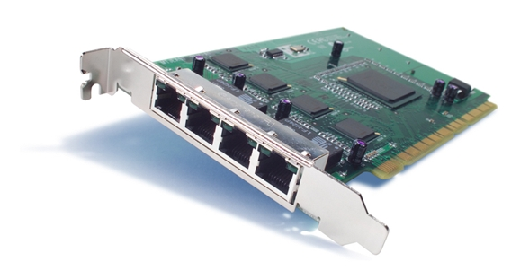
Port limitations
Low to medium speed of devices can be connected to computer
Few ports provided
To add new ports, the user must open the computer box to gain access to the internal expansion bus and install a new interface card. The user must also need to know how to configure the device and the software.
A USB makes it possible to add many devices to a computer system at any time without opening the computer box.
Cisco PIX 64-Bit/66-MHz 4-Port Fast Ethernet Interface Card

Slide 37
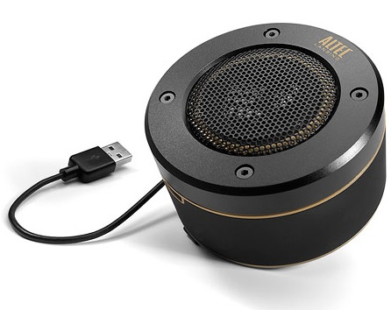

Plug and Play
The plug-and-play feature means that a new device (eg: speaker) can be connected at any time while the system is operating.
The system should detect the existence of this new device automatically, identify the appropriate device-driver software and any other facilities needed to service that device and establish the appropriate addresses and logical connections to enable them to communicate.
One of the primary objectives of the design of the USB has been to provide a plug-and-play capability.
Altec USB Speaker
Veho USB negative scanner

Slide 38
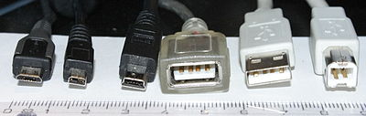

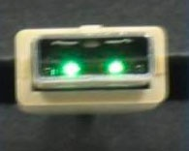
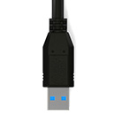
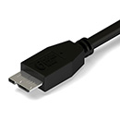

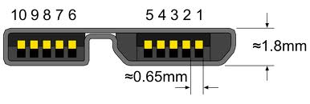
USB Connectors
USB 2.0
USB 3.0

Slide 39
USB Architecture
To accommodate a large number of devices that can be added or removed at any time, the USB has the tree structure.
Each node of the tree has a device called a hub, which acts as an intermediate control point between the host and the I/O devices. At the root of the tree, a root hub connects the entire tree to the host computer. The leaves of the tree are the I/O devices being served (eg: keyboard, Internet connection, speaker, or digital TV)
In normal operation, a hub copies a message that it receives from its upstream connection to all its downstream ports. As a result, a message sent by the host computer is broadcast to all I/O devices, but only the addressed device will respond to that message.
However, a message from an I/O device is sent only upstream towards the root of the tree and is not seen by other devices. Hence, the USB enables the host to communicate with the I/O devices, but it does not enable these devices to communicate with each other.

Slide 40
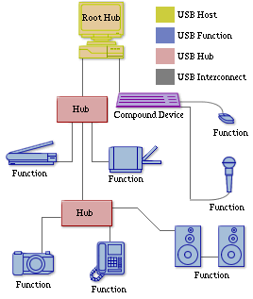
Universal Serial Bus tree structure
→Downstream Broadcast
→Upstream No Broadcast
Host computer
Root
hub
Hub
Hub
Hub
de
I/O
I/O
I/O
I/O
vice
de
vice
de
vice
de
vice
de
I/O
I/O
vice
de
vice

Slide 41
Basic concepts and nomenclature
USB is a polled bus(host hub polls for devices periodically), meaning the host controller must initiate all transfers. This DOES NOT mean that the system software must poll the USB. The host controller takes care of polling the bus and can be programmed to issue interrupts to the OS whenever the bus needs attention.
Figure 4.44(eg) split bus operation

Slide 42
Addressing (1)
When a USB is connected to a host computer,
Root hub is attached to the processor bus, where it appears as a single device.
The host software communicates with individual devices attached to the USB by sending packets of information, which the root hub forwards to the appropriate device in the USB tree.
Each device on the USB, whether it is a hub or an I/O device, is assigned a 7-bit address.
This address is local to the USB tree and is not related in any way to the addresses used on the processor bus.
A hub may have any number of devices or other hubs connected to it, and addresses are assigned arbitrarily. When a device is first connected to a hub, or when it is powered on, it has the address 0.

Slide 43
Addressing (2)
Periodically, the host polls each hub to collect status information and learn about new devices that may have been added or disconnected.
When the host is informed that a new device has been connected, it uses a sequence of commands to send a reset signal on the corresponding hub port,
read information from the device about its capabilities, send configuration information to the device, and assign the device a unique USB address.
Once this sequence is completed the device begins normal operation and responds only to the new address.

Slide 44
USB Protocols
All information transferred over the USB is organized in packets, where a packet consists of one or more bytes of information. There are many types of packets that perform a variety of control functions.
The information transferred on the USB can be divided into two broad categories: control and data.
Control packets perform such tasks as addressing a device to initiate data transfer, acknowledging that data has been received correctly, or indicating an error.
Data packets carry information that is delivered to a device.
A packet consists of one or more fields containing different kinds of information. The first field of any packet is called the packet identifier, PID, which identifies the type of that packet.
PIDs are transmitted twice. The first time they are sent with their true values, and the second time with each bit complemented.
The four PID bits identify one of 16 different packet types. Some control packets, such as ACK (Acknowledge), consist only of the PID byte.

Slide 45
PID₀ | PID₁ | PID₂ | PID₃ | PID₀ | PID₁ | PID₂ | PID₃
(a) Packet identifier field
Control packets used for controlling data transfer operations are called token packets.
Bits
8
7
4
5
PID
ADDR
ENDP
CRC16
(b) Token packet, IN or OUT
PID: Packet Identifier
CRC: Cyclic Redundancy Check (The CRC bits are computed based on the contents of address (ADDR) and endpoint (ENDP) fields.)
Bits
8
0 to 8192
16
PID
D
A
T
A
CRC16
(c) Data packet
CRC protects all non-PID fields in token and data packets from errors during transmission.

Slide 46
Host
Hub
I/O De
evice
T
ok
en
Data0
A
CK
Time
T
ok
en
Data0
A
CK
An output transfer
T
ok
en
Data1
A
CK
T
ok
en
Data1
A
CK

Slide 47
PID Type | PID Name | PID [3:0] | Description
Token | OUT | 0001b | The packet describes a host-to-function transaction.
 | IN | 1001b | The packet describes a function-to-host transaction.
 | SOF | 0101b | The packet marks the start of frame and specifies the frame number.
 | SETUP | 1101b | Packet describes a SETUP transaction from the host to the function via a control pipe.
Data | DATA0 | 0011b | This packet is an even data packet.
 | DATA1 | 1011b | This packet is an odd data packet
 | DATA2 | 0111b | This packet is only used in high-speed, high-bandwidth isochronous transfers.
 | MDATA | 1111b | This packet is only used in split transactions, or high-speed, high-bandwidth isochronous transfers.
Handshake | ACK | 0010b | This packet acknowledges the successful receipt of a data packet.
 | NAK | 1010b | This packet indicates that data is not ready to be transmitted yet.
 | STALL | 1110b | This packet indicates that the endpoint has halted, or a control pipe does not support a certain request.
 | NYET | 0110b | The receiver has not yet responded, or the host should begin sending PING packets.
Special | PRE | 1100b | This packet is a host-issued preamble for a split-transaction.
 | ERR | 1100b | This packet is a handshake response that a split transaction error occurred. Note that this PID is identical to the PID for a PRE packet.
 | SPLIT | 1000b | This packet supports split transactions between the host and a high-speed hub.
 | PING | 0100b | This packet is used for flow-control in high-speed control and bulk transfers.
 | Reserved | 0000b | This is a reserved PID and must not be used.
PID Types (in USB 2.0)

Slide 48
Isochronous Traffic on USB
One of the key objectives of the USB is to support the transfer of isochronous data (such as sampled voice).
Devices that generates or receives isochronous data require a time reference to control the sampling process.
To provide this reference, transmission over the USB is divided into frames of equal length.
A frame is 1ms long for low-and full-speed data.
The root hub generates a Start of Frame control packet (SOF) precisely once every 1 ms to mark the beginning of a new frame.
To assist devices that may need longer periods of time, the SOF packet carries an 11-bit frame number.
Each device will have an opportunity for an input or output transfer once every 1 ms.
Example
Transmission of 8 bytes of data requires a 3 byte token packet followed by a 11-byte data packet(PID+CRC)=136bits

Slide 49
USB Frames
SOF FRAME
PID(8bit) | FRAME NUMBER(11bit) | CRC 5(5bit)
FRAME EXAMPLE
S | T3 | D | T7 | D | ……… | ……….. | S | T3 | D
S→SOF FRAME PACKET
Tn→ Token Packet, n=addredd
D→ Data Packet

